Slide 1
Cleaning and Merging
Dataset needed the following changes
  Capitalization issues. For instance, having both Ford and ford for the make of the car. These are treated as two categories, not one.
  The sale date format was problematic. The sale year was extracted from the sale date.
  Deleting nulls caused issue with visualizations and therefore were backed out.
Merging datasetsS was difficult
  Make, Model and Year was not possible.
  One dataset had a column called ‘trim’ whereas another included this data in model.
  Further, one dataset combined multiple models.

Slide 2
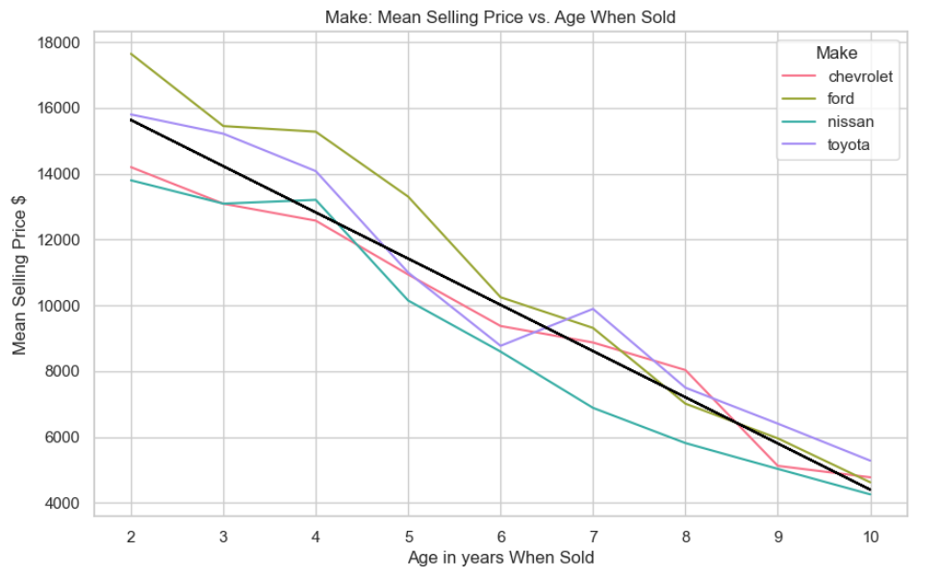
Statistics
The r-value is -0.96
Slope is -$1,403
Conclusion
All makes depreciate at about the same rate.

Slide 3
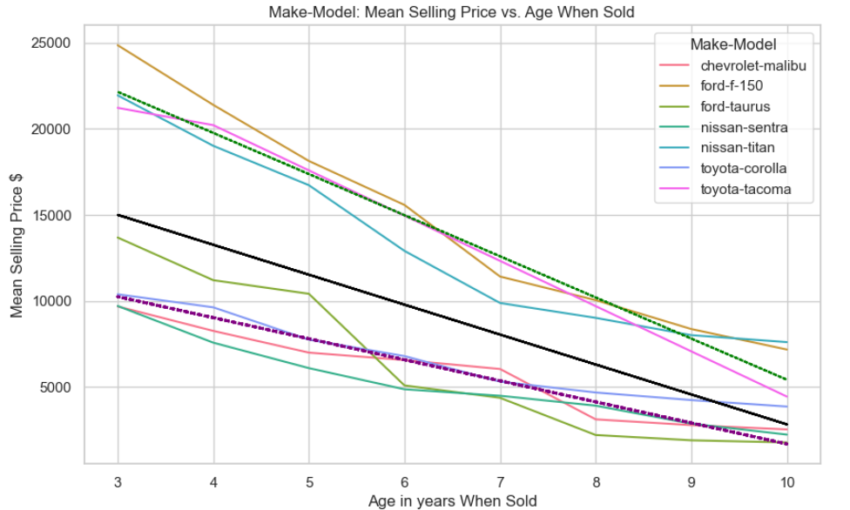
Statistics
Black regression line for all vehicles has an r-value of -0.69
The purple regression line is for cars and has a r-value of -0.91
The green line represents trucks, with a -0.97 r-value. Slope is -$2,388.
Conclusion
The model fits better when run on type of vehicle, showing a finer level of granularity is needed.

